Slide 1





TRIGGERING MECHANISM FOR SHM & THE ISSUE – SENSING SCHEME
Always-on
Duty-cycle
Event-triggered
active
inactive
events of interest
partially miss out
inactive miss out
low power miss out
Notes:
SENSING SCHEME

Slide 2
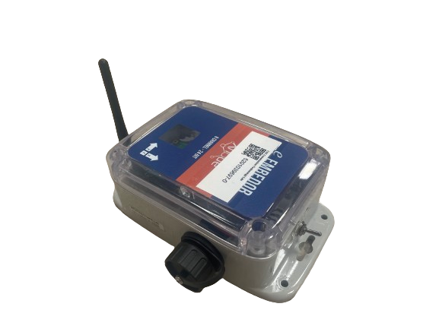
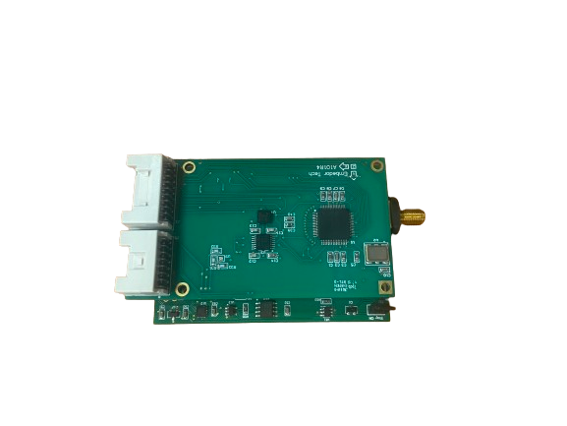
TRIGGERING MECHANISM FOR SHM & THE ISSUE – SENSING SCHEME
low power mode：
DIGITAL ACCELEROMETER: ADXL362
- resolution: 12-bit
- power consumption: 1.8uA (sensing, 100Hz) ; 270nA (sleep)
high resolution mode：
LIS344
ANALOG ACCELEROMETER - LIS344
ADC – ADS131E08
- resolution: 24-bit
- power consumption: ~ 5mW (sensing); 3uA(sleeping)
wakeup
ADXL362
Notes:
SENSING SCHEME

Slide 3
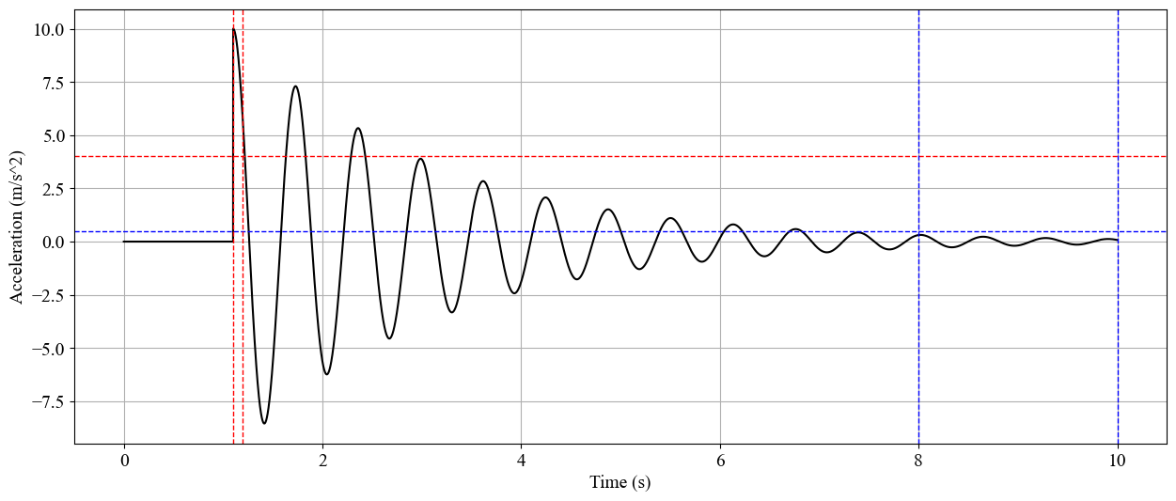
TRIGGERING MECHANISM FOR SHM & THE ISSUE – TRIGGER SENSING
Activation
Duration
Activation
Threshold
Deactivation
Threshold
Deactivation
Duration
can be viewed as a two-class classifier： events of interest / no interest
Notes:
TRIGGER SENSING
This mechanism can be viewed as a filter

Slide 4
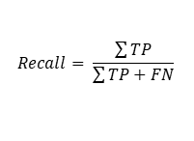
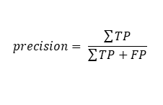
TRIGGERING MECHANISM FOR SHM & THE ISSUE – TYPE I & II ERROR
Triggering Sensing Objectives:
reduce missed out events of interests. - ⬆️ Recall
reduce false alarms. - ⬆️ Precision
Ground Truth
positive
negative
True Positive (TP)
False Positive (FP)
[TYPE I]
positive
$$precision= \frac{\sum{TP}}{\sum{TP+FP}}$$
Prediction
False Negative (FN)
[TYPE II]
True Negative (TN)
negative
Negatively Related
interested
not interested
$$Recall= \frac{\sum{TP}}{\sum{TP+FN}}$$
Notes:
TYPE I & II ERROR

Slide 5
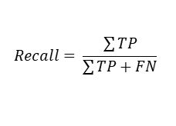
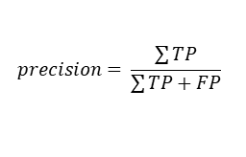
TRIGGERING MECHANISM FOR SHM & THE ISSUE – CHALLENGES
Ground Truth
CHALLENGES
positive
negative
Imbalanced Data & Unknown Distribution
True Positive
(TP)
False Positive
(FP)
positive
$$precision= \frac{\sum{TP}}{\sum{TP+FP}}$$
No Ground Truth
Prediction
Partial Observability
False Negative
(FN)
True Negative
(TN)
Long Time & Costful Feedback
negative
$$Recall= \frac{\sum{TP}}{\sum{TP+FN}}$$
Notes:
CHANLLENGES & NOVELTIES

Slide 6
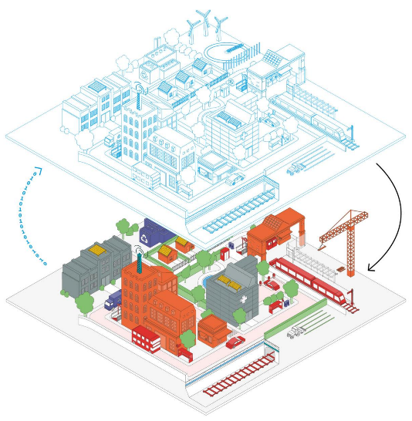

SOLUTION: FEEDBACK LOOP CONTROL SYSTEM + DIGITAL TWIN
DIGITAL SPACE
monitoring
diagnosis
simulation
predictions
optimization
control
...
ENVIRONMENT
SYSTEM/PROCESS
data
CONTROLLER
information
shape
vibration
temp.
humidity
…
ESTIMATOR
PHYSICAL SPACE
DIGITAL TWIN
FEEDBACK LOOP CONTROL

Slide 7





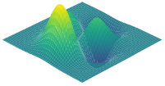
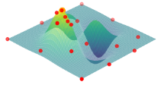

SOLUTION: FEEDBACK LOOP CONTROL SYSTEM
ENVIRONMENT – EXCITATION & STRUCTURE
SYSTEM – TRIGGERING MECHANISM
response signal
duration
threshold
reference
EXCITATION
PHYSICAL STRUCTURE
CONTROLLER – BAYESIAN OPTIMIZATION
captured signal
$$F_{β}$$
$$F_{β}$$
threshold
duration
threshold
duration
threshold
duration
EVALUATOR – F-BETA CALCULATION
$$F_{β}$$
SURROGATE MODEL
- GPR
BAYESIAN OPTIMIZATION
TP
TP + FP
PREPROCESS
$$\left(1+β^{2}\right)\frac{P∙R}{β^{2}∙P+R}$$
PRECISION
$$F_{β}$$
TP
TP + FN
RECALL
CNN

Slide 8
SOLUTION: FEEDBACK LOOP CONTROL SYSTEM
CLASSIFIER NN TRAINING
PREPROCESS
EXCITATION+SIMULATION
PHYSICAL STRUCTURE & DIGITAL TWIN
CNN
INTEREST CORE + AMBIENT VIBRATION
Imbalanced Data & Unknown Distribution

Slide 9

SOLUTION: FEEDBACK LOOP CONTROL SYSTEM + DIGITAL TWIN
ENVIRONMENT – EXCITATION & STRUCTURE
SYSTEM – TRIGGERING MECHANISM
response signal
duration
threshold
reference
EXCITATION
PHYSICAL STRUCTURE & DIGITAL TWIN
CONTROLLER – BAYESIAN OPTIMIZATION
$$F_{β}$$
$$F_{β}$$
duration
threshold
threshold
duration
threshold
duration
EVALUATOR – F-BETA CALCULATION
$$F_{β}$$
SURROGATE MODEL
- GPR
BAYESIAN OPTIMIZATION
TP
PREPROCESS
captured signal
P
TP + FP
$$\left(1+β^{2}\right)\frac{P∙R}{β^{2}∙P+R}$$
PRECISION
CNN
$$F_{β}$$
R
threshold
R
duration
RECALL
DNN

Slide 10
CLASSIFIER NN TRAINING
PREPROCESS
EXCITATION+SIMULATION
PHYSICAL STRUCTURE & DIGITAL TWIN
CNN
INTEREST CORE + AMBIENT VIBRATION
PREDICTOR NN TRAINING
EXCITATION+SIMULATION
PHYSICAL STRUCTURE & DIGITAL TWIN
TRIGGERING MECHANISM
CNN
INTEREST CORE + AMBIENT VIBRATION

Slide 11

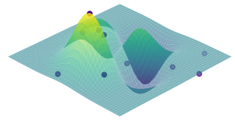
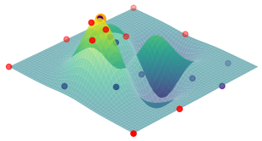

Excitation Simulated/Transferred
Digital Model
Response Signal
duration
Excitation in Digital Space
threshold
Excitation in Physical Space
Physical Structure
Response Signal
duration
threshold
reference
ENVIRONMENT
– EXCITATION & STRUCTURE
SYSTEM
– TRIGGERING MECHANISM
$$F_{β}$$
$$F_{β}$$
duration
threshold
threshold
duration
threshold
duration
PHASE I
PHASE II
captured signal
CONTROLLER
– BAYESIAN OPTIMIZATION
- SURROGATE MODEL - GPR
TP
PREPROCESS
event type
$$F_{β}$$
$$F_{β}$$
P
TP + FP
EVENT TYPE
captured signal
$$\left(1+β^{2}\right)\frac{P∙R}{β^{2}∙P+R}$$
PRECISION
CNN
PREPROCESS
R
Threshold/Duration
threshold
duration
R
Recall (TP/(TP+FN))
TP & FN
RECALL
Threshold/Duration
threshold
duration
EVALUATOR
– F-BETA CALCULATION
DNN
LEGEND
Real Data
Training Data
Physical Space
Digital Space
NN Training
Estimation

Slide 12

Excitation Simulated/Transferred
Digital Model
Response Signal
duration
Excitation in Digital Space
threshold
Excitation in Physical Space
Physical Structure
Response Signal
duration
threshold
reference
ENVIRONMENT
– EXCITATION & STRUCTURE
SYSTEM
– TRIGGERING MECHANISM
$$F_{β}$$
$$F_{β}$$
duration
threshold
threshold
duration
threshold
duration
PREPROCESS
captured signal
PHASE I
PHASE II
TP
EVENT TYPE
event type
$$F_{β}$$
CONTROLLER
– BAYESIAN OPTIMIZATION
- SURROGATE MODEL - GPR
$$F_{β}$$
P
TP + FP
PREPROCESS
captured signal
$$\left(1+β^{2}\right)\frac{P∙R}{β^{2}∙P+R}$$
PRECISION
CNN
threshold
duration
R
Threshold/Duration
TP & FN
R
Recall (TP/(TP+FN))
threshold
duration
RECALL
Threshold/Duration
EVALUATOR
– F-BETA CALCULATION
DNN
LEGEND
Real Data
Training Data
Physical Space
Digital Space
NN Training
Estimation

Slide 13

Excitation Simulated/Transferred
Digital Model
Response Signal
duration
Excitation in Digital Space
threshold
Excitation in Physical Space
Physical Structure
Response Signal
duration
threshold
reference
ENVIRONMENT
– EXCITATION & STRUCTURE
SYSTEM
– TRIGGERING MECHANISM
$$F_{β}$$
$$F_{β}$$
duration
threshold
threshold
duration
threshold
duration
PREPROCESS
captured signal
PHASE I
PHASE II
TP
EVENT TYPE
event type
$$F_{β}$$
CONTROLLER
– BAYESIAN OPTIMIZATION
- SURROGATE MODEL - GPR
$$F_{β}$$
P
TP + FP
PREPROCESS
captured signal
$$\left(1+β^{2}\right)\frac{P∙R}{β^{2}∙P+R}$$
PRECISION
CNN
threshold
duration
R
Threshold/Duration
TP & FN
R
Recall (TP/(TP+FN))
threshold
duration
RECALL
Threshold/Duration
EVALUATOR
– F-BETA CALCULATION
DNN
LEGEND
Real Data
Training Data
Physical Space
Digital Space
NN Training
Estimation

Slide 16
FEEDBACK LOOP CONTROL SYSTEM
ENVIRONMENT
SYSTEM/PROCESS
CONTROLLER
ESTIMATOR

Slide 17
DIGITAL TWIN
data
shape
vibration
temp. & humidity
…
monitoring & recording
diagnosis & prognosis
simulation & predictions
optimization & control
...
information
Notes:
https://www.12dsynergy.com/wp-content/uploads/2022/05/Digital-Twin-City-Graphic-600px.png

Slide 18

DIGITAL TWIN
DIGITAL TWIN
monitoring & recording
diagnosis & prognosis
simulation & predictions
optimization & control
...
data
information
shape
vibration
temp. & humidity
…
PHYSICAL SPACE
Notes:
https://www.weforum.org/agenda/2020/09/how-we-can-get-real-value-from-infrastructure/
https://www.linkedin.com/pulse/evolution-built-environment-james-doubtfire/

Slide 19



Slide 20

ENVIRONMENT (DIGITAL)
– EXCITATION & STRUCTURE
Response Signal
SYSTEM (DIGITAL)
– TRIGGERING MECHANISM
Excitation in Digital Space
threshold
Excitation Simulated/Transferred
Digital Model
duration
Excitation in Physical Space
Physical Structure
Response Signal
duration
threshold
ENVIRONMENT (PHYSICAL)
– EXCITATION & STRUCTURE
SYSTEM (PHYSICAL)
– TRIGGERING MECHANISM
$$F_{β}$$
$$F_{β}$$
TP
PREPROCESS
threshold
duration
threshold
duration
$$F_{β}$$
P
TP + FP
EVENT TYPE
SURROGATE MODEL
- GPR
BAYESIAN OPTIMIZATION
$$\left(1+β^{2}\right)\frac{P∙R}{β^{2}∙P+R}$$
PRECISION
PREPROCESS
CONTROLLER – BAYESIAN OPTIMIZATION
Threshold/Duration
R
R
Recall (TP/(TP+FN))
RECALL
Threshold/Duration
EVALUATOR – F-BETA CALCULATION

Slide 21

ENVIRONMENT (DIGITAL)
– EXCITATION & STRUCTURE
Response Signal
SYSTEM (DIGITAL)
– TRIGGERING MECHANISM
Excitation in Digital Space
threshold
Excitation Simulated/Transferred
Digital Model
duration
Excitation in Physical Space
Physical Structure
Response Signal
duration
threshold
ENVIRONMENT (PHYSICAL)
– EXCITATION & STRUCTURE
SYSTEM (PHYSICAL)
– TRIGGERING MECHANISM
Processed Signal
CNN FOR EVENT CLASSIFICATION
Event Types
CNN
Threshold & Duration
DNN FOR RECALL
REGRESSION
Recall (TP/(TP+FN))
DNN
EVALUATOR – F-BETA CALCULATION
P
TP
PREPROCESS
captured signal
TP + FP
$$\left(1+β^{2}\right)\frac{P∙R}{β^{2}∙P+R}$$
PRECISION
CNN
$$F_{β}$$
R
threshold
R
duration
RECALL
DNN

Slide 22





ENVIRONMENT (DIGITAL)
– EXCITATION & STRUCTURE
SYSTEM (DIGITAL)
– TRIGGERING MECHANISM
Excitation Simulated/Transferred
Digital Model
Response Signal
duration
Excitation in Digital Space
threshold
Excitation in Physical Space
Physical Structure
duration
Response Signal
threshold
reference
ENVIRONMENT (PHYSICAL)
– EXCITATION & STRUCTURE
SYSTEM (PHYSICAL)
– TRIGGERING MECHANISM
$$F_{β}$$
$$F_{β}$$
threshold
duration
threshold
duration
duration
threshold
SURROGATE MODEL
- GPR
BAYESIAN OPTIMIZATION
PREPROCESS
captured signal
$$F_{β}$$
$$F_{β}$$
TP
EVENT TYPE
event type
CONTROLLER – BAYESIAN OPTIMIZATION
P
TP + FP
PREPROCESS
captured signal
$$\left(1+β^{2}\right)\frac{P∙R}{β^{2}∙P+R}$$
PRECISION
CNN
threshold
duration
R
Threshold/Duration
TP & FN
R
Recall (TP/(TP+FN))
threshold
duration
RECALL
DNN
Threshold/Duration
EVALUATOR – F-BETA CALCULATION

Slide 23
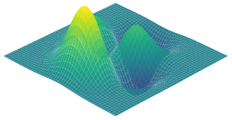


Excitation Simulated/Transferred
Digital Model
Response Signal
duration
Excitation in Digital Space
threshold
Excitation in Physical Space
Physical Structure
Response Signal
duration
threshold
reference
ENVIRONMENT
– EXCITATION & STRUCTURE
SYSTEM
– TRIGGERING MECHANISM
$$F_{β}$$
$$F_{β}$$
LEGEND
Real Data
Physical Space
duration
threshold
Training Data
Digital Space
threshold
duration
threshold
duration
Estimation
NN Training
SURROGATE MODEL - GPR
BAYESIAN OPTIMIZATION
captured signal
CONTROLLER
– BAYESIAN OPTIMIZATION
TP
PREPROCESS
event type
$$F_{β}$$
$$F_{β}$$
P
TP + FP
EVENT TYPE
captured signal
$$\left(1+β^{2}\right)\frac{P∙R}{β^{2}∙P+R}$$
PRECISION
CNN
PREPROCESS
R
Threshold/Duration
threshold
duration
R
Recall (TP/(TP+FN))
TP & FN
RECALL
Threshold/Duration
threshold
duration
EVALUATOR
– F-BETA CALCULATION
DNN

